Slide 1
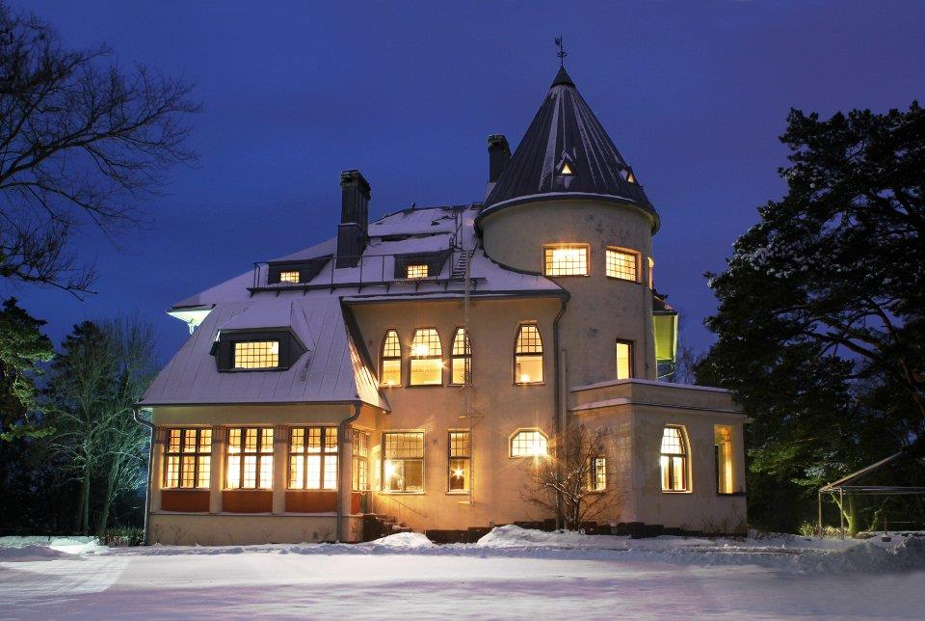
Seminar for Experienced Internal Auditors and experts of GRC
Helsinki
9-10 February 2017
Registration and further details:
www.nordiclight.fi
Key Notes, Master classes and Roundtable discussions
Current and emerging topics
Specific track for Public Sector
Speakers:
Angela Witzany, Chairwoman of IIA Global
Lesedi Lesetedi, Audit Committee Chair UNICEF
Mark Carawan, Chief Internal Auditor Citigroup
Melvyn Neate, Board Member ECIIA
Jarno Limnell, VP Cyber Security Insta Group Ltd
Markku Pottonen, Principal Auditor The ECA
and many more

